Slide 1
Back-Testing For Stock Market Strategies
By:
Darshan ,Priyanshu ,Tanmay & Yash

Slide 2
Problem statement
To Make A Back Testing Algorithm to Check Different Trading Strategies.

Slide 3
General Hypothesis
To Trade or Invest In a Company, certain People use Different Trading Strategies.
First, we have to download the accurate data into excel sheets.
Then after that we have to make formula applicable in excel for indicators used in strategies.
But Still We Can’t Use Excel To Back-Test Strategies.

Slide 4
General Hypothesis
Contd..
Problems with this process: -
It is a very long process.
Finding Accurate Data is Much Harder as we’ve experienced such problem.
Making Formulas In Excel Isn’t Easy, For Complex Algorithms(formulas) of Indicators.
To Even Find Correct Formulas For indicators & Back testing Algorithm is a challenge.
We Will Have to Update Data Again & Again after each Day because Stock-Market changes Everyday.

Slide 5
Proposed Hypothesis
Our Website Will Overcome all The Previously Stated Problems because it will directly take data from Internet as per the date entered.
Algorithms Will Be Programmed & will be more efficient than in excel.
It Will be Much Faster Comparatively.

Slide 6
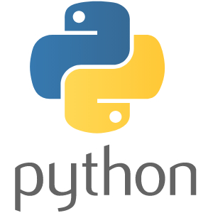
Software Requirements
Python – To Code The Complex Algorithms.

Slide 7


Python Libraries
Django – As a framework to Integrate Our Python Code into Html Easily.
Pandas – To Fetch Data From The Internet.

Slide 8

Software Requirements
Contd..
PyCharm – To Easily Compile, Run & Organize python code.

Slide 9

Software Requirements
Contd..
GitHub – To Be Easily able to contribute to the code by team members & To Organize our Code as we make Progress.

Slide 10




Software Requirements
Contd..
Text Editors – To easily manage Different Files at once while working with different files altogether.

Slide 11
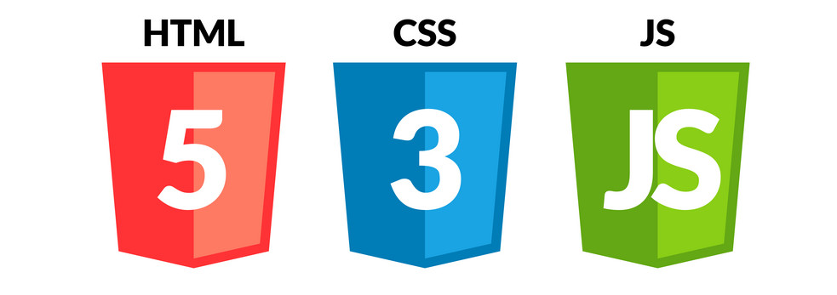
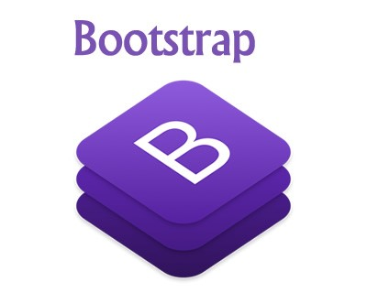
Software Requirements
Contd..
For Front End:- To Make A series of Webpages with distinct design.

Slide 12
Project Progress

Slide 13
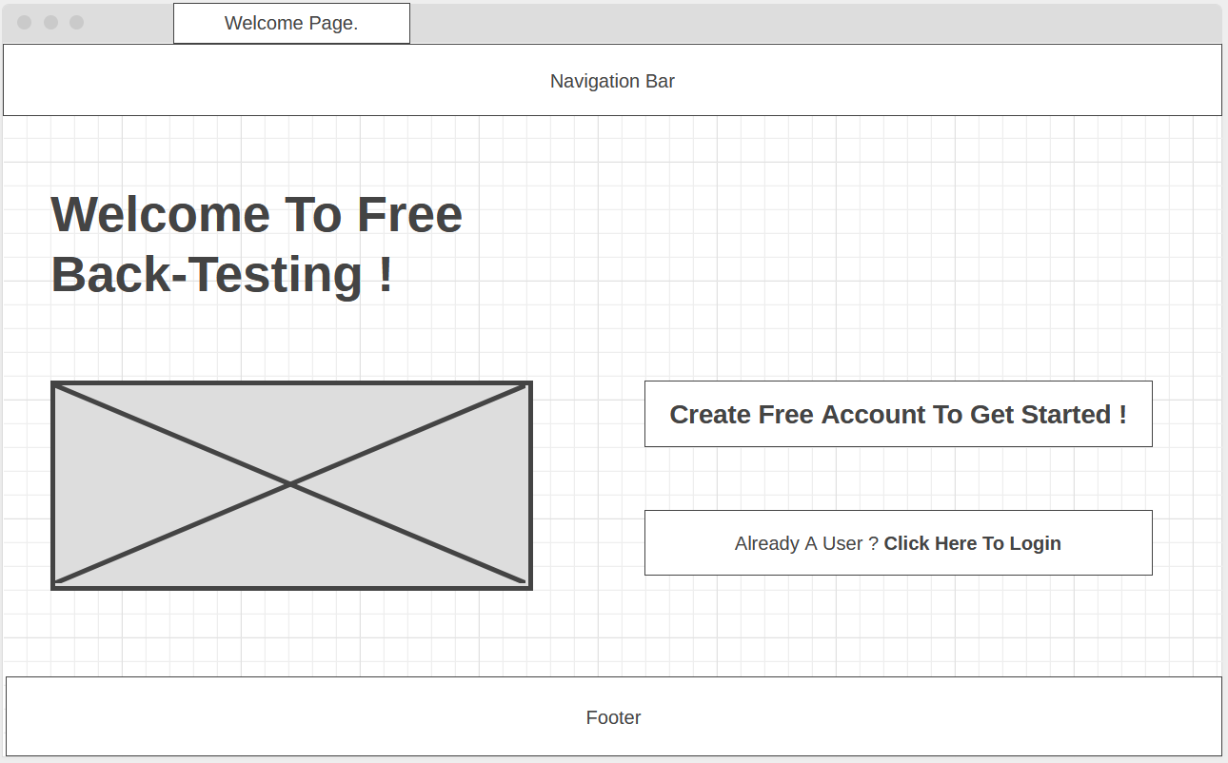
Prototypes For Front-End

Slide 14
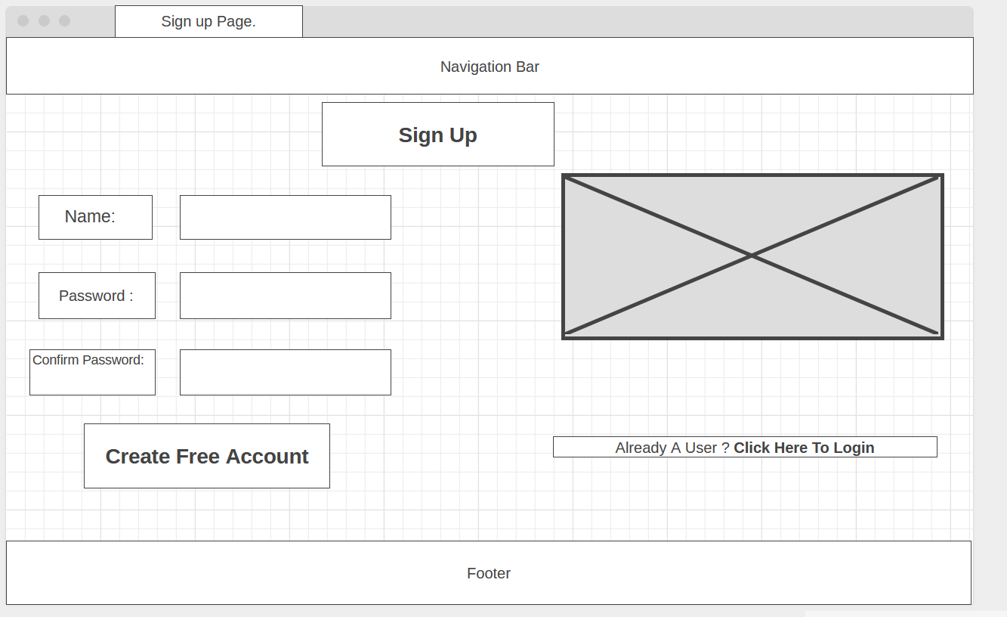
Prototypes For Front-End
Contd..

Slide 15
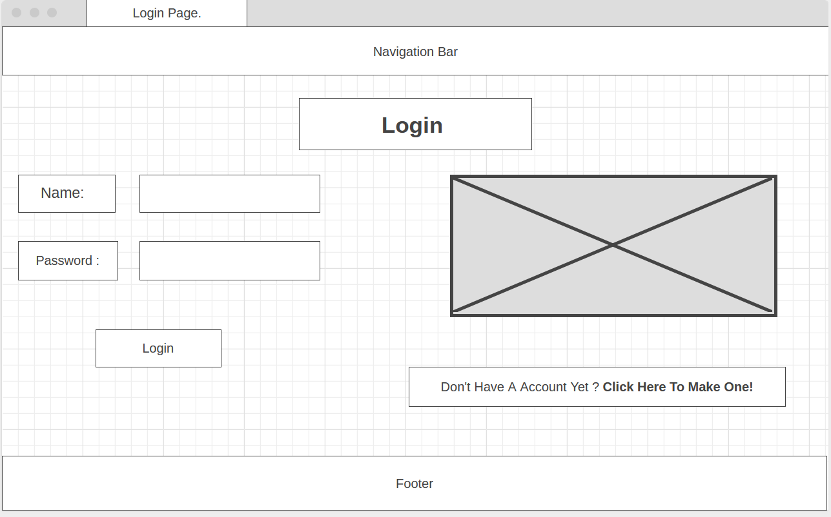
Prototypes For Front-End
Contd..

Slide 16
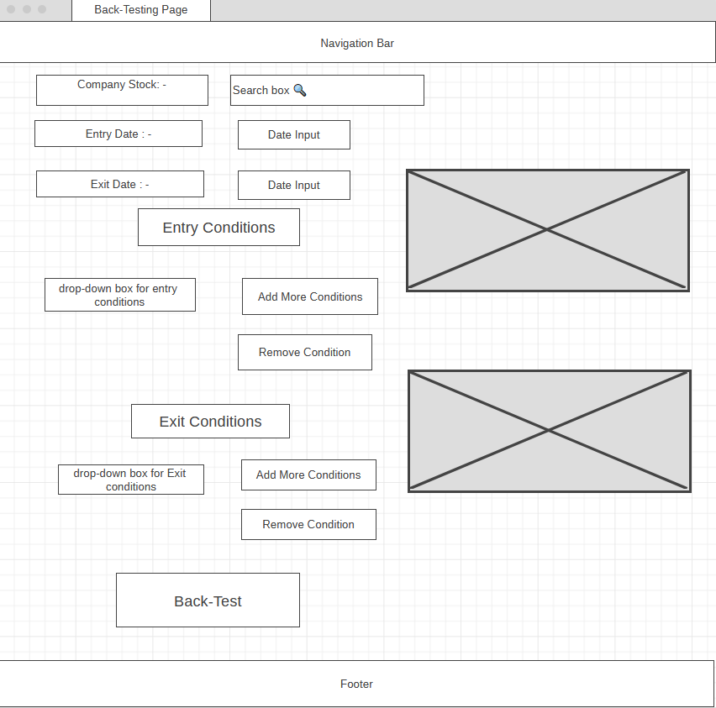
Prototypes For Front-End
Contd..

Slide 17
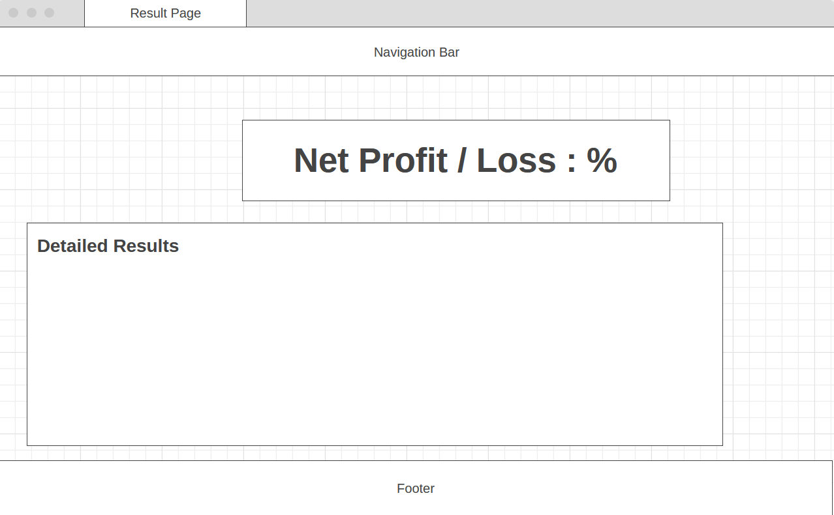
Prototypes For Front-End
Contd..

Slide 18
Roles Of Each Group Member
Coding Indicators will be done by all.
Priyanshu will Code the Back Testing Algorithm.
Tanmay will Integrate that code to HTML & make a basic set of webpages.
Darshan & Yash will use HTML,CSS,JS & BOOTSTRAP to design our website into our desired stage.

Slide 19
Expected Outcome
On Completion of project : -
For Us:-
Learn Python, Django, HTML, CSS, JAVASCRIPT, BOOTSTRAP, etc.
Team Work.
How to deal with such future projects.
For Project Purposes:-
→ A Working Website that show profit/loss in % by back-testing of different strategies, using different & multiple indicators.

Slide 20
References
Yahoo For Fetching Data of different Stocks/Companies.
Trading View- https://in.tradingview.com/chart/- as a reference to check our algorithms for indicators & also to few formulas for indicators.
Investopedia - https://www.investopedia.com/ &
Stock charts - https://stockcharts.com/ for formulas of different indicators.
Wireframing - https://wireframe.cc/ for making website’s wireframe(sketch).

Slide 21
Thank You !

